Slide 1
SMART
PARKING LOT
Start Date: 09/21/2016 – End Date: 11/05/2016-
Budget: 11000USD

Slide 2
SMART PARKING LOT PROJECT
TEAM MEMBERS:
Nguyễn Thị Ánh Nguyệt
Vương Nhật Quang
Nguyễn Viết Huỳnh
Trương Tấn Luân
Trần Thanh Huy
Instructor:
- Võ Văn Lường
Jan Samuelsson

Slide 3
DESCRIPTION
Smart parking lot valued choices for future.
On the world have quite a lot of this technology, but Vietnam is not common yet. Only HO CHI MINH and HA NOI sore neck this technology.
In Vietnam, traffic terrain is not planned an organized planning and futuristic. So, roads are pretty cramped but many family owned modern means.The more traffic congestion increase. Follow our research, i’ve see many garage under roadway . Especially, car and pickups regularly try to go into the small roads . HO CHI MINH and HA NOI solution build underground parking below apartment but it's only meet a fraction.
And we also don’t except Danang city . So, we decide to implement "Smart parking lot" project . It has many advantages such:
Easy parking and vehicle management, reducing traffic jam, ensuring safety for the user.

Slide 4
DESCRIPTION
Intellegent Parking M5 building Nguyen Chi Thanh Hanoi: built yet save space, pay by cash, be time-consuming and difficult to manage, do not be quick.
Keep vehicle manually: which don't manage vehicle, must to pay by cash, not safety for vehicle, dosen't not manage expense
My System: fast, not cash, safety users, safety vehicle, sa-ve space, high security, and login by fingerprints.

Slide 5
VISION
For Business Enterprises Parking Who a smart parking system The smart parking lot Is a application That Our software help managing vehicle easiler, reducing traffic jams, ensuring safity for people to buy cars packed house, keep vehicles are not wet when it rains, protecting the street landscape, saving time unlike Nowaday traditional parking lot, that is not modern in managing cost and risks. Nowaday, many parking lot use card to manage,but it's not fase, and moreover security is not good product or service Our product, that optimizes fast and safely, help to save space, help pay fast, and has high security

Slide 6
LIST of ACTORS
Customer | Who, follow sales statistics, changes requirements of system.
Users | Who participate in system, send and take vehicles.
Admin | Who manage system, has authority to change, add information of system, is trained to control the system.

Slide 7
LIST of USE CASES
ID | Use Case Name | Primary Actor | Scope | Complexity | Priority
1 | Login | Admin, User | In | H | 1
2 | Logout | Admin, User | In | H | 1
3 | Add User | Admin | In | H | 1
4 | Delete User | Admin | In | M | 2
5 | Update Users Information | Admin | In | L | 3
6 | Cancel Users Information | Admin | In | L | 3
7 | Add Parking Lot | Admin | In | M | 2
8 | Cancel Parking Lot | Admin | In | L | 3
9 | Check Parking Lot | Admin | In | H | 1
10 | Credit Card | User | In | H | 1
11 | Bank Account | User | In | H | 1
12 | Changes The Password | User | In | H | 1
13 | Delete My Account | User | In | M | 2
14 | History | User | In | H | 1
15 | Send The Car | User | In | H | 1
16 | Take The Car | User | In | H | 1
17 | Languages | User, Admin | In | M | 3
18 | Upgrades | Customer | In | H | 1
19 | Statistics Financial | Customer | In | H | 1

Slide 8
USE CASE DETAIL
Use Case ID | UC1
Name | Login
Description | Admin login on the system by this account
Actor | Admin
Precondition | Internet, admin and user must have account
Basic of Friends | Steps 1. Enter user name and password Steps 2. The system check account, if enter wrong user name or password, the system require you re-enter user name and password Steps 3. If enter the connect account user name and password, the system will display the following functions

Slide 9
USE CASE DETAIL
Use Case ID | UC2
Name | Logout
Description | Admin logout on the system by their account
Actor | Admin
Precondition | Internet, admin and user must be logged into the system
Basic of Friends | Steps 1. Enter into logout on the system Steps 2. The system will show” got rid of the system ”

Slide 10
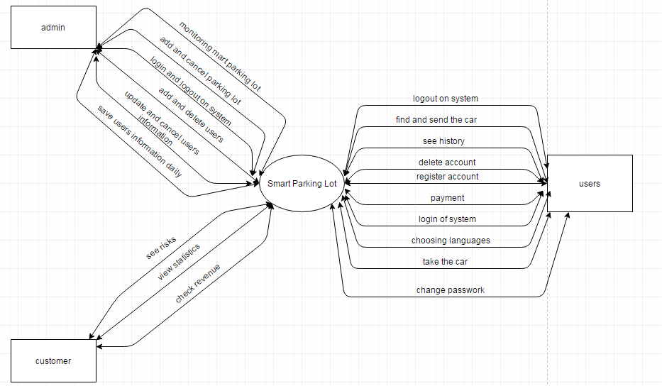
CONTEXT DIAGRAM

Slide 11
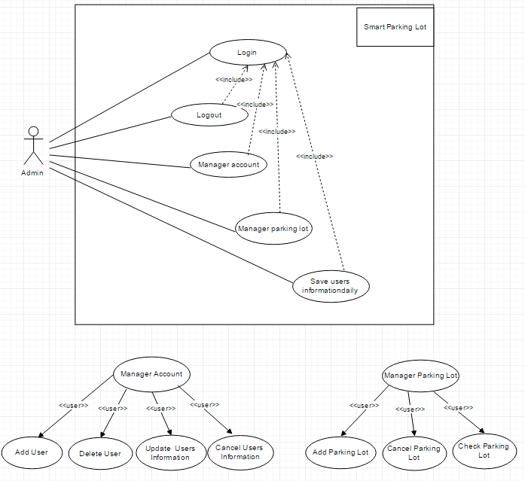
USE CASE DIAGRAM 1

Slide 12
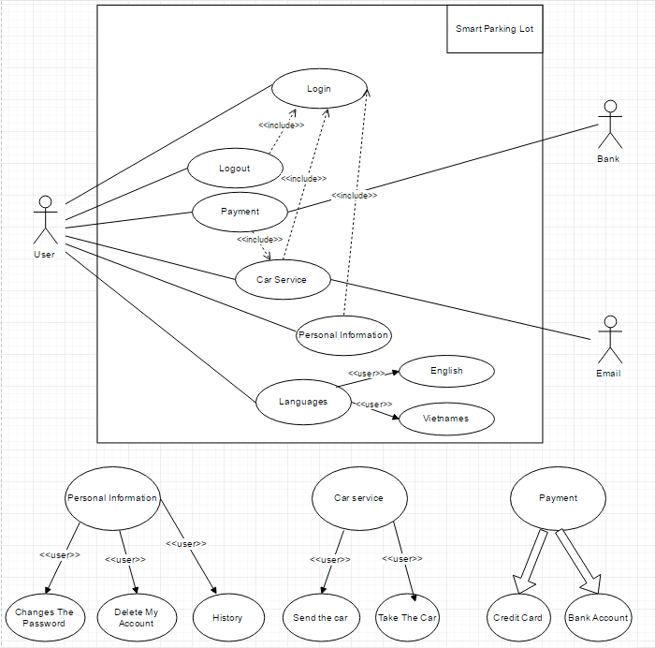
USE CASE DIAGRAM 2

Slide 13
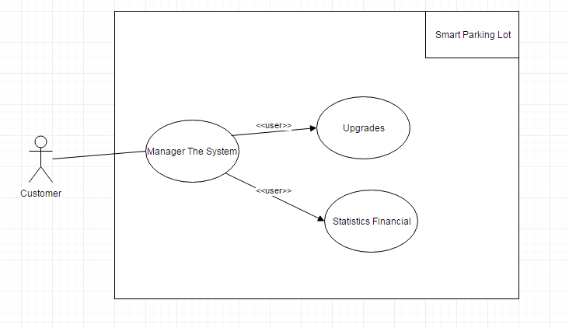
USE CASE DIAGRAM 3

Slide 14
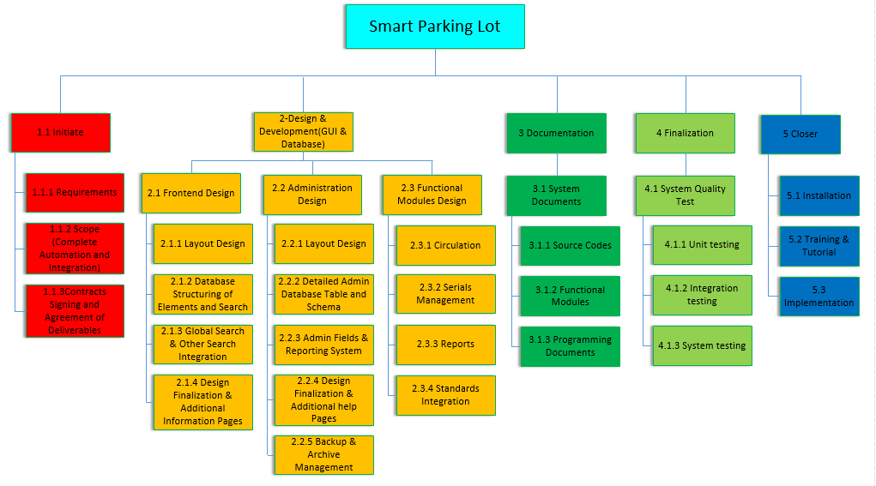
WORK BREAKDOWN STRUCTURE

Slide 15
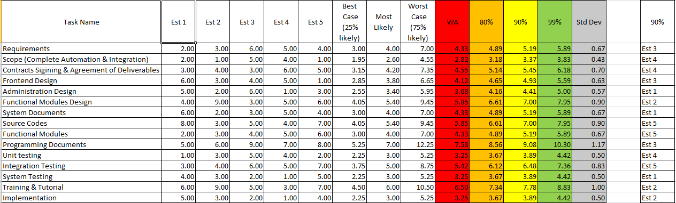

Slide 16
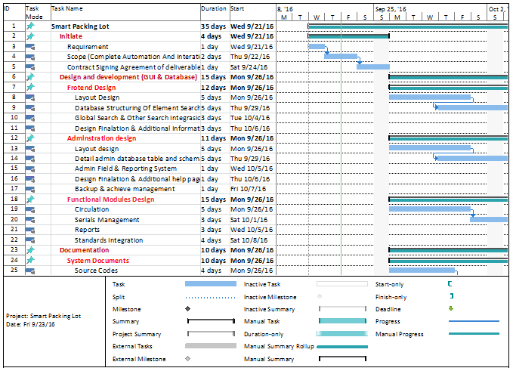
LIST of USE CASES

Slide 17
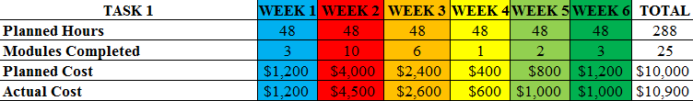
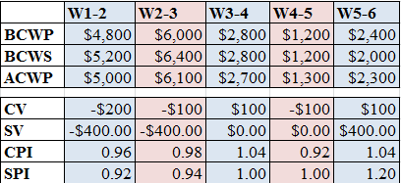

Slide 18
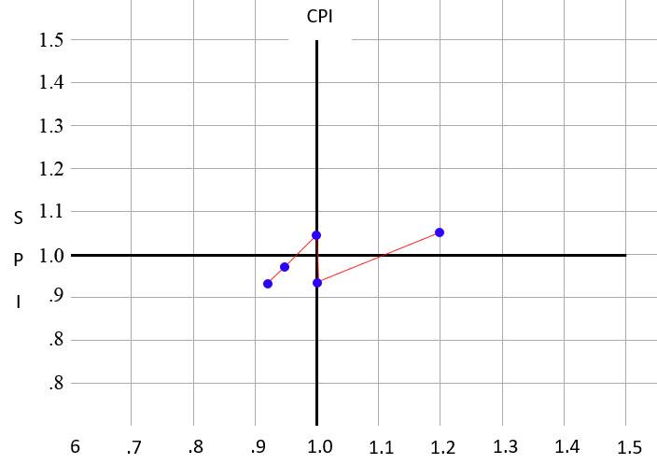

Slide 19




Thank you for Listening !

